Slide 1

A Missional Budget
Ministry Growth Gathering
Creating and Communicating the Missional Budget
Notes:
1
As we begin I would like to open with one of the occasional prayers found in the Book of Common Prayer 2019.

Slide 2
A Missional Budget
O merciful Creator, Your Loving hand is open wide to satisfy the needs of every living creature: Make us always thankful for Your Loving providence, and give us Grace to honor You with all that You have entrusted to us;
Notes:
2
Will you pray with me:
O merciful Creator, Your Loving hand is open wide to satisfy the needs of every living creature:
Make us always thankful for Your Loving providence, and give us Grace to honor You with all that You have entrusted to us;

Slide 3
A Missional Budget
that we, remembering the account we must one day give, may be faithful stewards of Your good gifts; through Jesus Christ our Lord, who with You and the Holy Spirit lives and reigns, one God, for ever and ever. Amen.
Notes:
3
that we, remembering the account we must one day give, may be faithful stewards of Your good gifts; through Jesus Christ our Lord, who with You and the Holy Spirit lives and reigns, one God, for ever and ever. Amen.

Slide 4
A Missional Budget
O merciful Creator, Your Loving hand is open wide to satisfy the needs of every living creature: Make us always thankful for Your Loving providence, and give us Grace to honor You with all that You have entrusted to us; that we, remembering the account we must one day give, may be faithful stewards of Your good gifts; through Jesus Christ our Lord, who with You and the Holy Spirit lives and reigns, one God, for ever and ever. Amen.

Slide 5
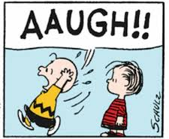
A Missional Budget

Slide 6

A Missional Budget

Slide 7
A Missional Budget
What did Jesus say about our relationship to wealth?
What did God breath into Scripture about wealth management?
What is God calling us specifically to do?

Slide 8
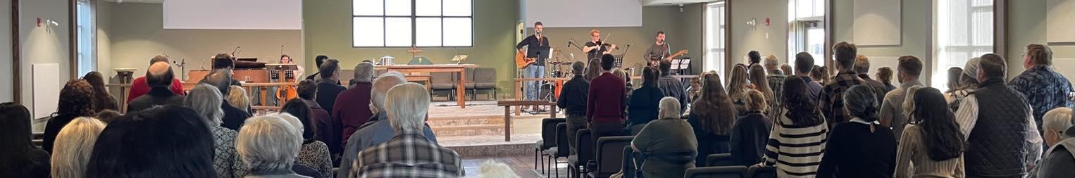
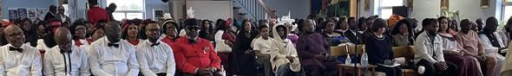
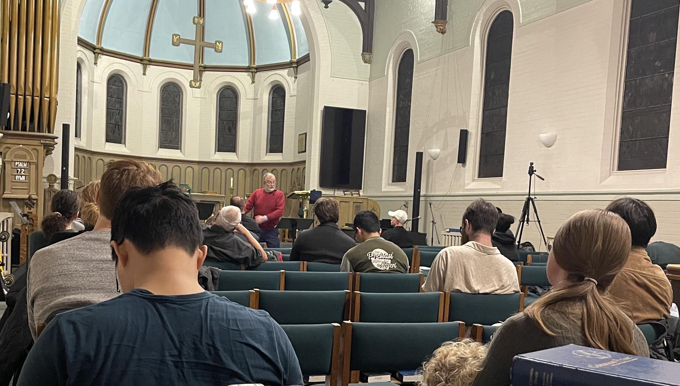
A Missional Budget

Slide 9
A Missional Budget
Evangelical
Catechism
Pastoral
Devotional
Instructional
Inspirational
Missional

Slide 10

A Missional Budget
Don’t Worry …
be happy!!

Slide 11
A Missional Budget
“And how are they to preach unless they are sent?
As it is written, “How beautiful are the feet of those who preach the good news!”
…faith comes from hearing, and hearing through the word of Christ.
Romans 10:15, 17

Slide 12
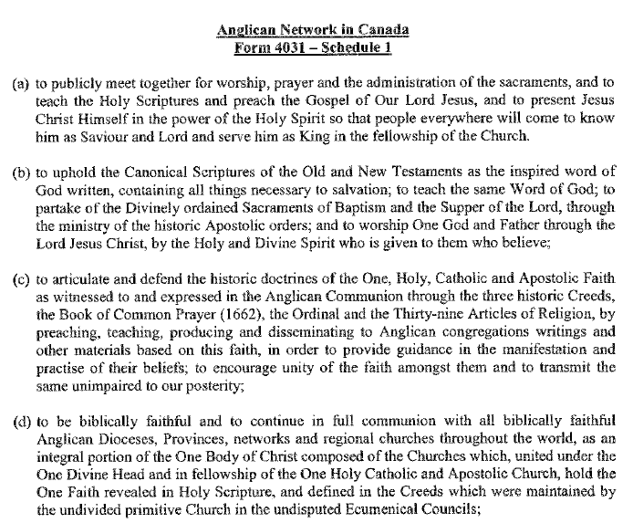
A Missional Budget

Slide 13
A Missional Budget
“And how are they to preach unless they are sent?
As it is written, “How beautiful are the feet of those who preach the good news!”
…faith comes from hearing, and hearing through the word of Christ.
Romans 10:15, 17

Slide 14
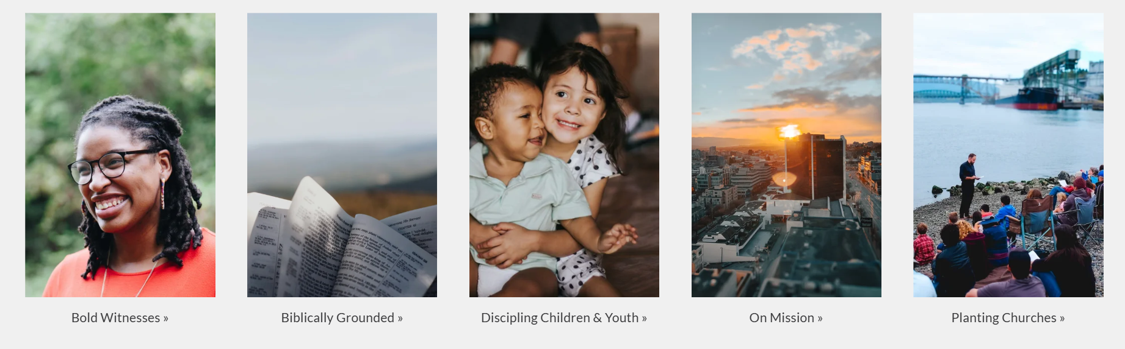
A Missional Budget

Slide 15
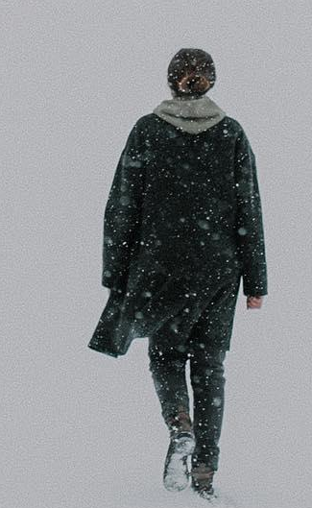

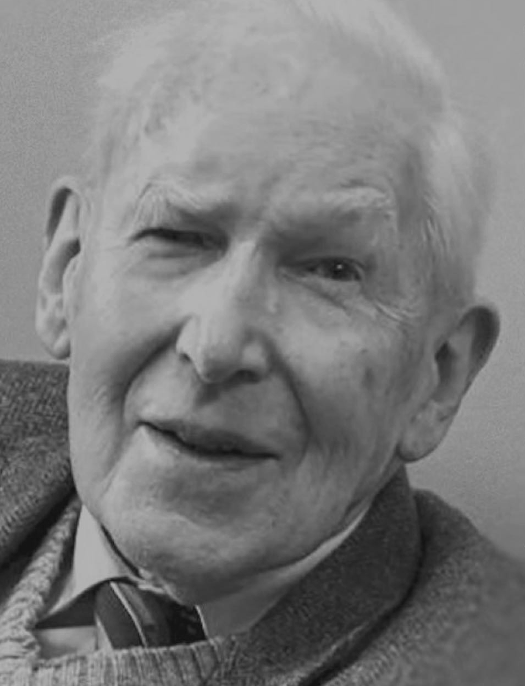
Multiply for Missions
Church Plant
Curacies
Packer College
A Missional Budget

Slide 16

A Missional Budget

Slide 17
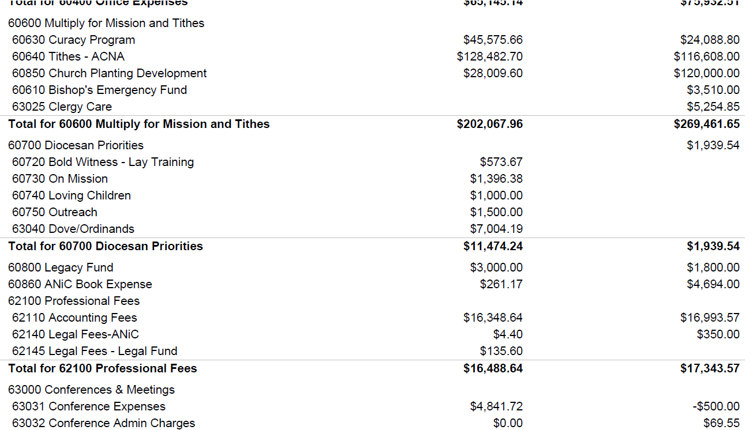
A Missional Budget

Slide 18

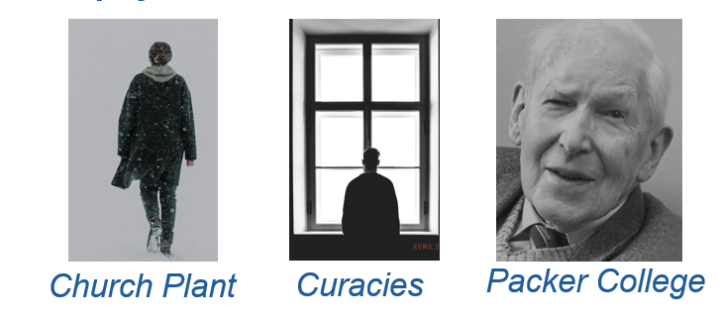
A Missional Budget
Luke 14:28-30

Slide 19
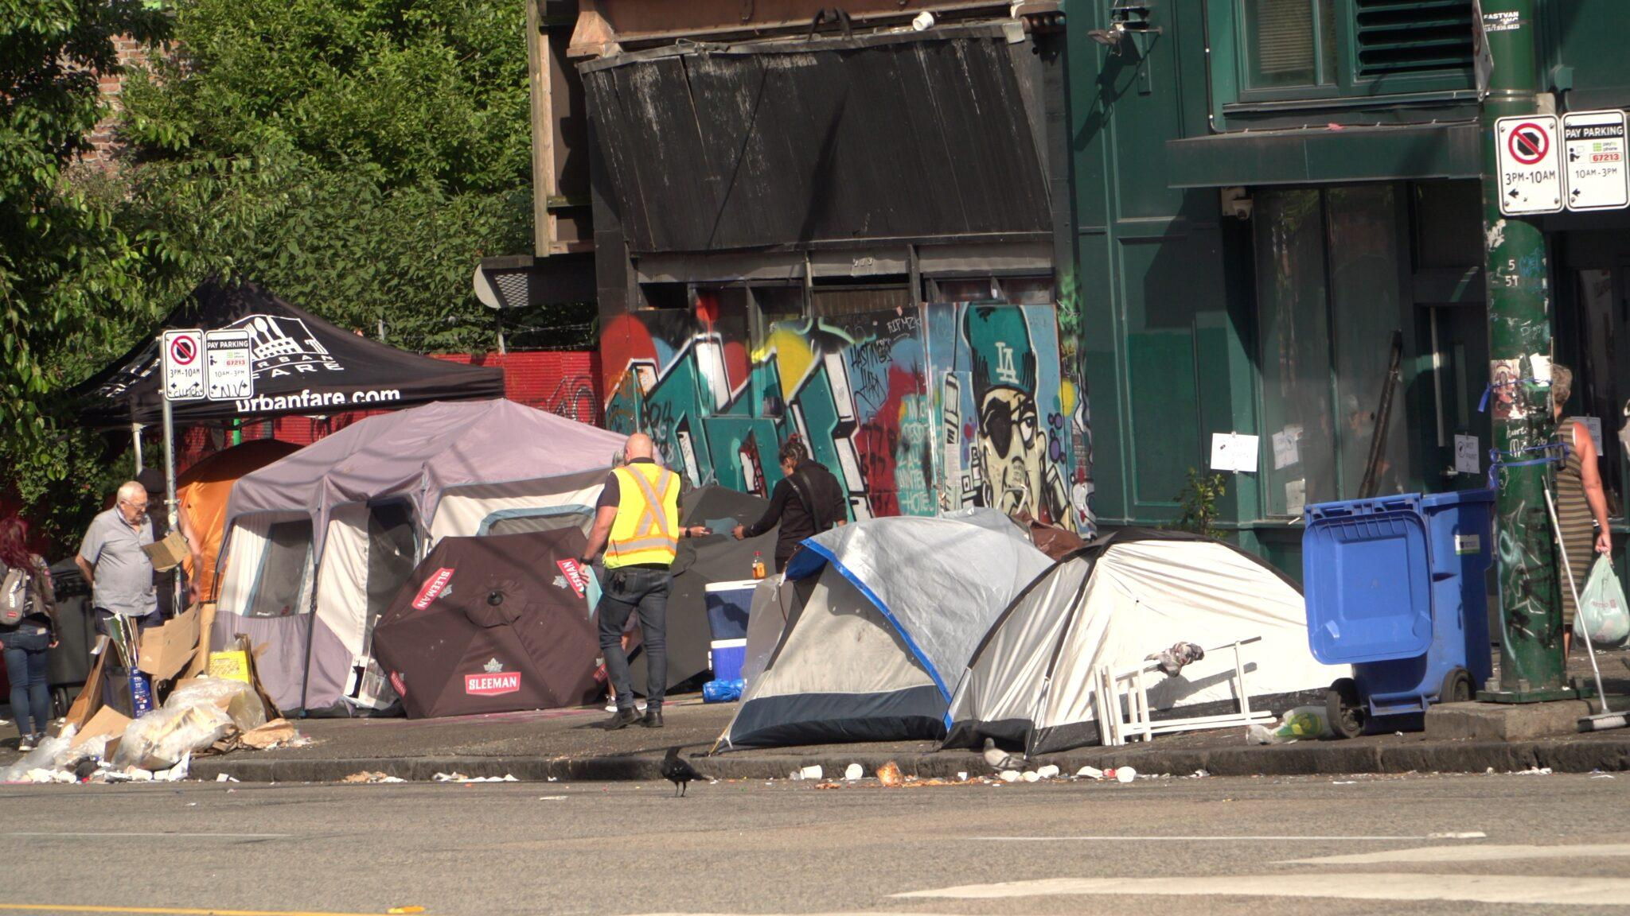
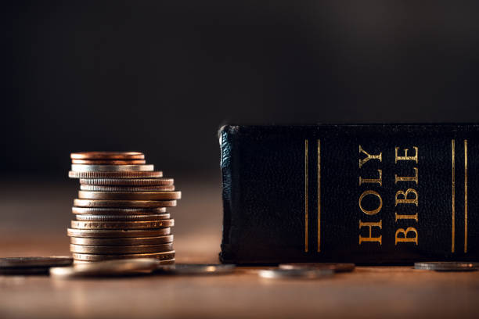
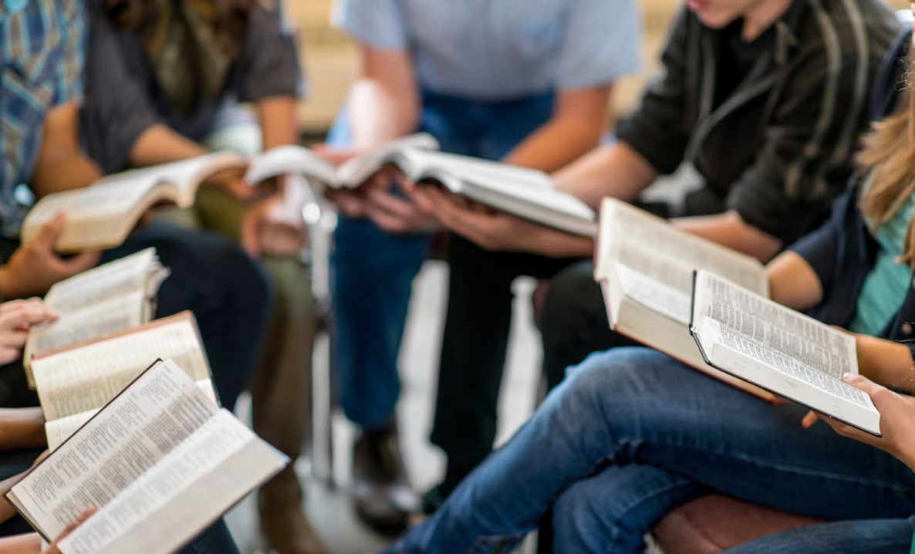
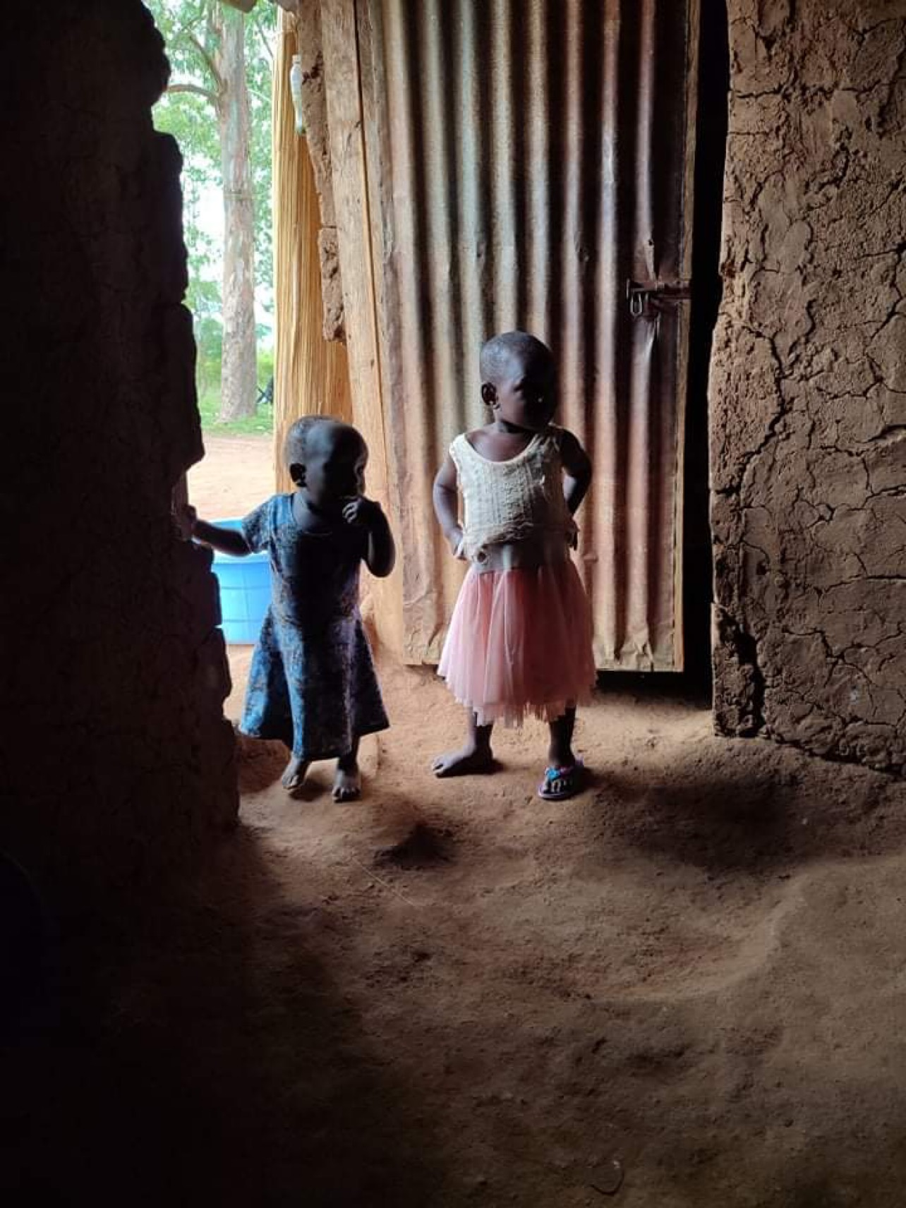
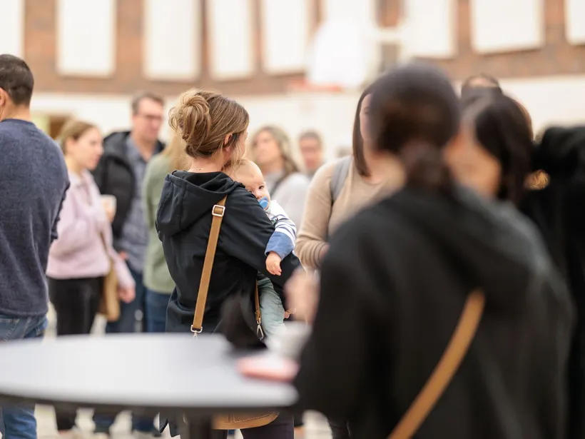

A Missional Budget
Notes:
There is so much we could do.
And so it’s easy for us to get scattered and distracted.
It’s too easy for resource management to become unfocused and ineffective.
We can’t do everything.
So, though it may hurt, we humble ourselves and ask, what is God trusting us to do here and now.

Slide 20
A Missional Budget
Luke 14:28-30

Slide 21
A Missional Budget
How does each expenditure advance our discerned mission priorities?

Slide 22
A Missional Budget
God’s purpose through us is faith that is enlivened by hearing His Word.

Slide 23
A Missional Budget
Luke 14:28-30

Slide 24
A Missional Budget
The Budget Process so far:
As a congregation of Christ’s Church
commissioned by God to GO and Speak and bear witness
guided by Scripture, a mission statement, and legal purposes in our governing documents
commits to certain mission specific tasks
and reviews past expense efficiency .

Slide 25
A Missional Budget
And we have reviewed, sorted, analyzed and categorized our historic data.

Slide 26
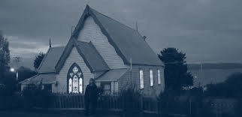
A Missional Budget

Slide 27
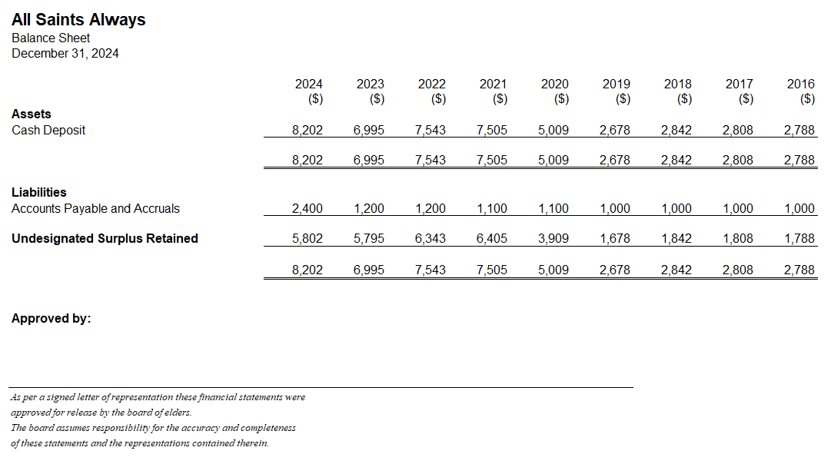
A Missional Budget

Slide 28
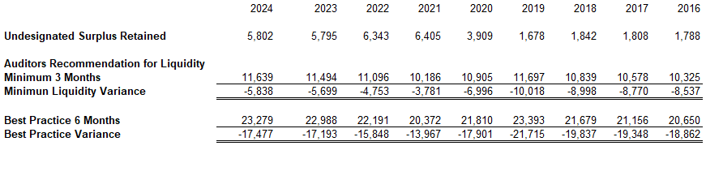
A Missional Budget
Liquidity Reserve:

Slide 29
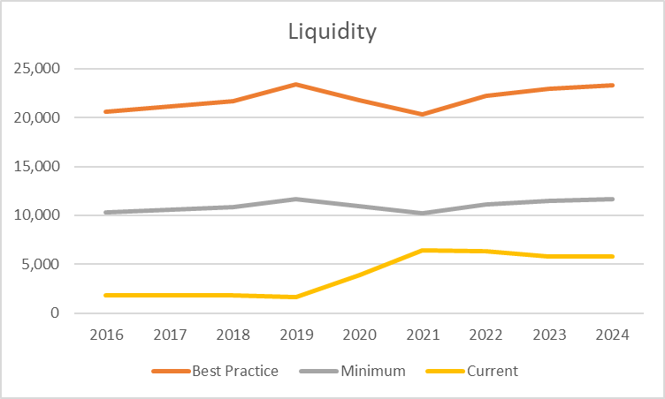
A Missional Budget
Liquidity Reserve:

Slide 30
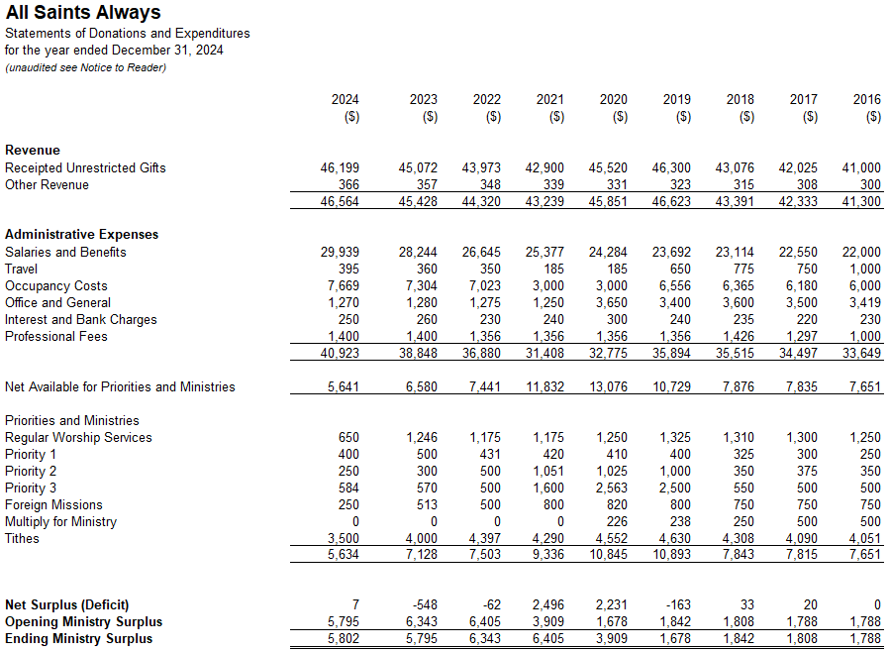
A Missional Budget

Slide 31
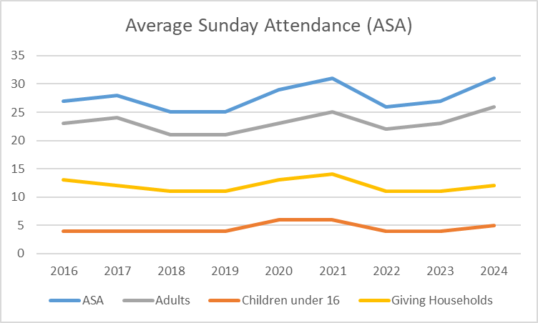
A Missional Budget

Slide 32
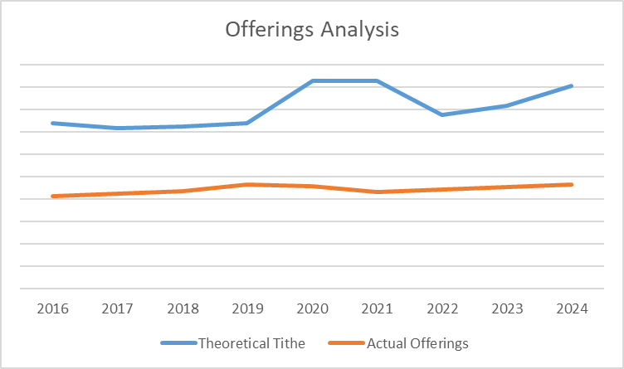
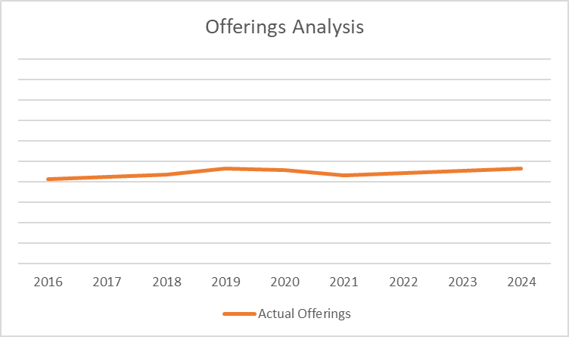
A Missional Budget

Slide 33
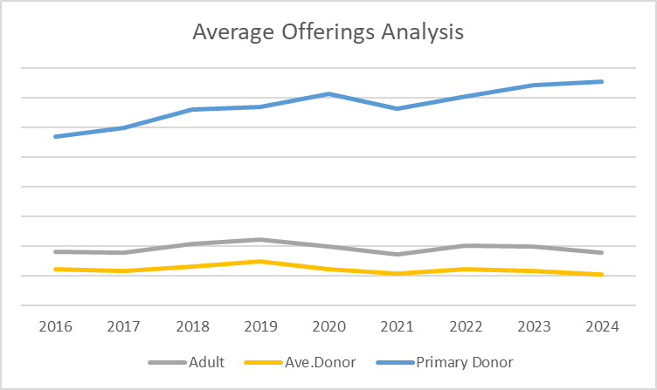
A Missional Budget

Slide 34
A Missional Budget
O merciful Creator, Your Loving hand is open wide to satisfy the needs of every living creature: Make us always thankful for Your Loving providence, and give us Grace to honor You with all that You have entrusted to us; that we, remembering the account we must one day give, may be faithful stewards of Your good gifts; through Jesus Christ our Lord, who with You and the Holy Spirit lives and reigns, one God, for ever and ever. Amen.

Slide 35
A Missional Budget
Almighty God our Savior, You desire that none should perish, and you have taught us through your Son that there is great joy in heaven over every sinner who repents:
Grant that our hearts may ache for a lost and broken world. May your Holy Spirit work through our words, deeds, and prayers, that the lost may be found and the dead made alive, and that all your redeemed may rejoice around your throne; through Jesus Christ our Lord. Amen.

Slide 36
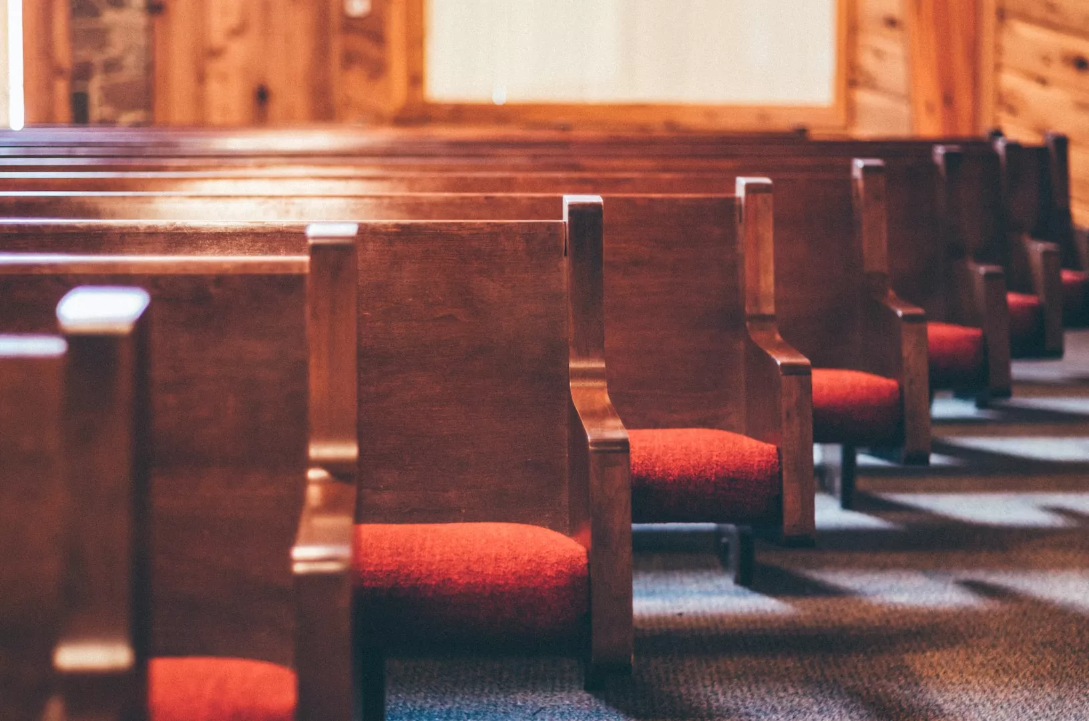
A Missional Budget

Slide 37
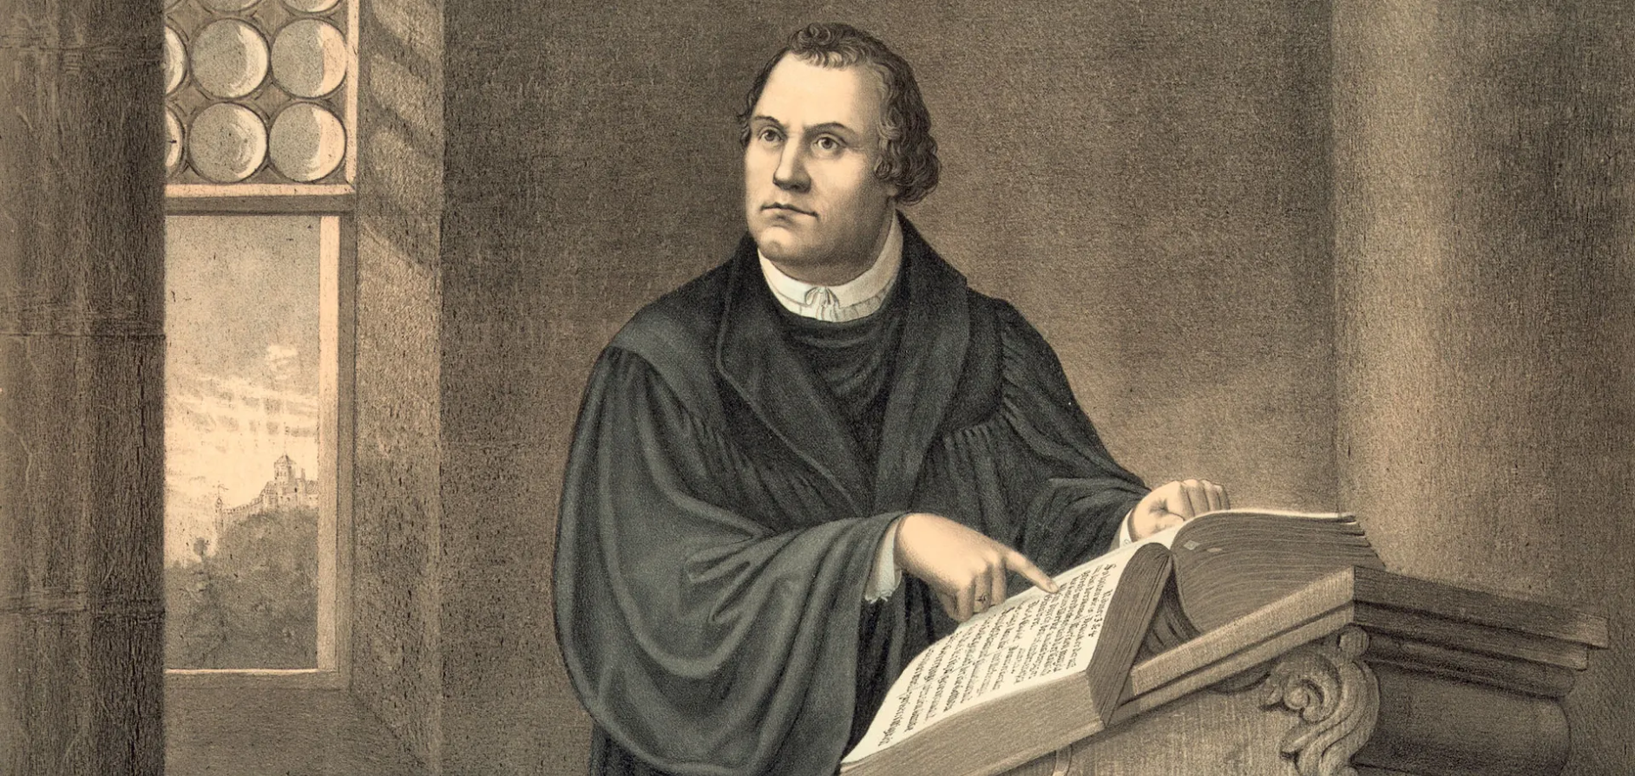
A Missional Budget

Slide 38
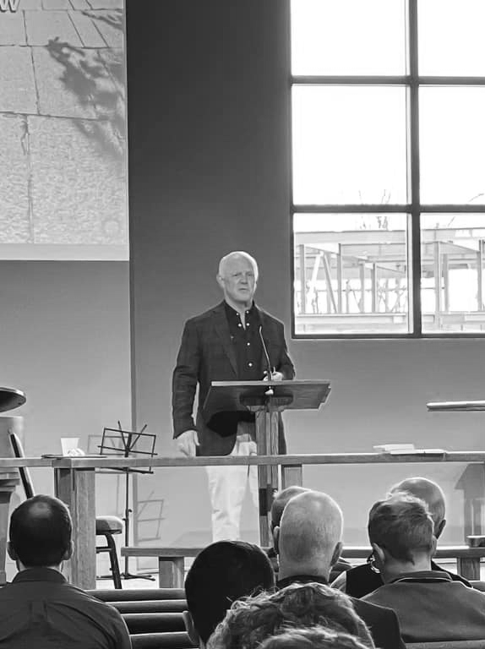
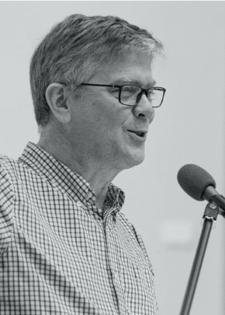
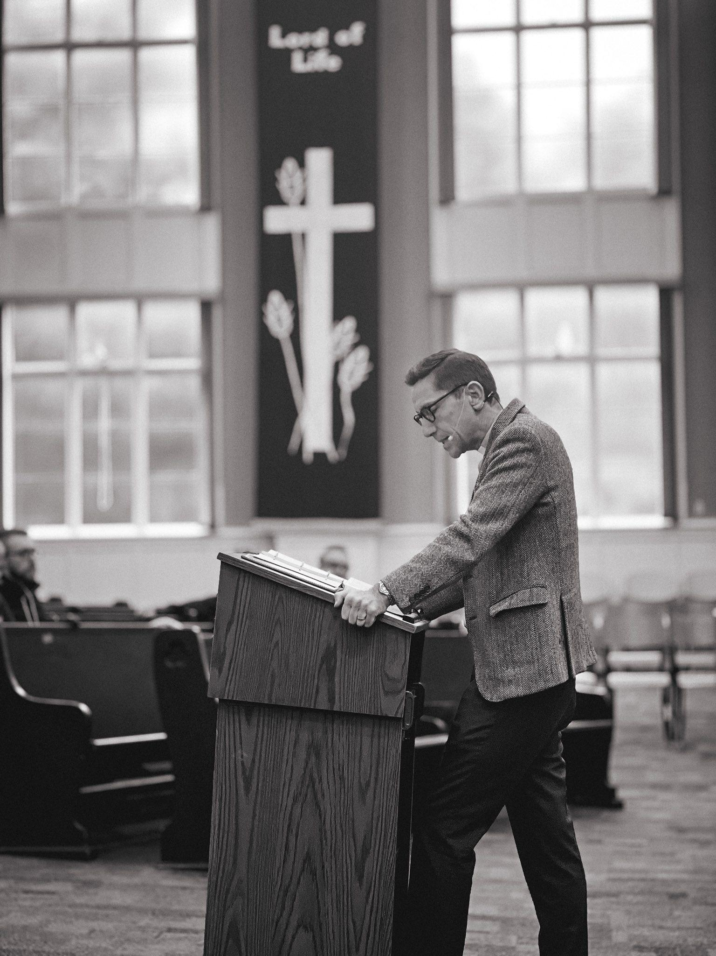
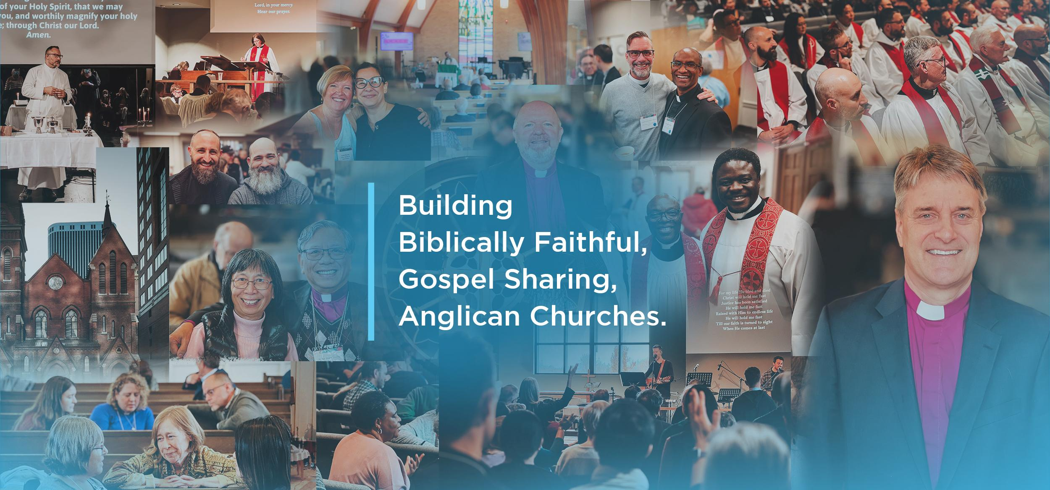
A Missional Budget

Slide 39

A Missional Budget

Slide 40
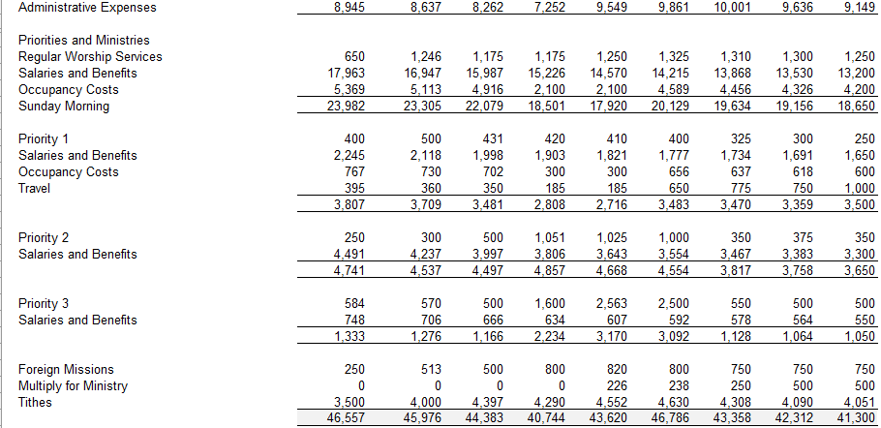
A Missional Budget

Slide 41
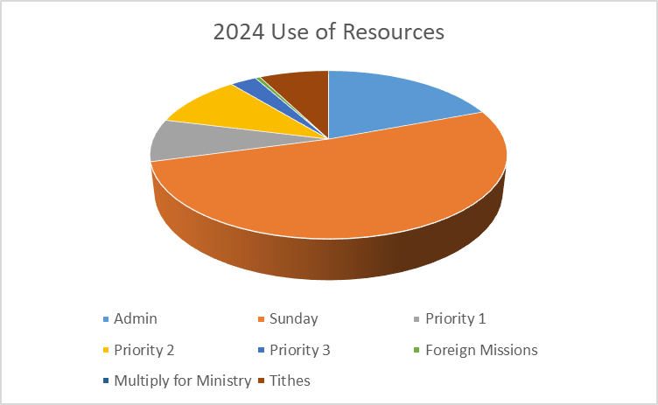
A Missional Budget

Slide 42
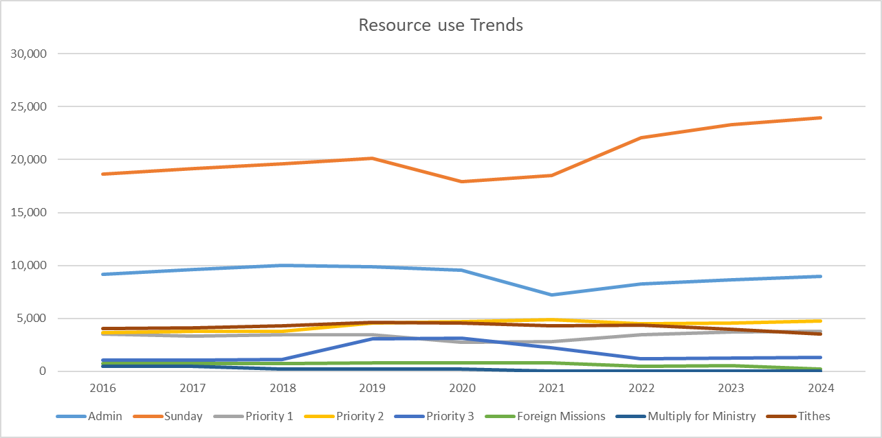
A Missional Budget

Slide 43

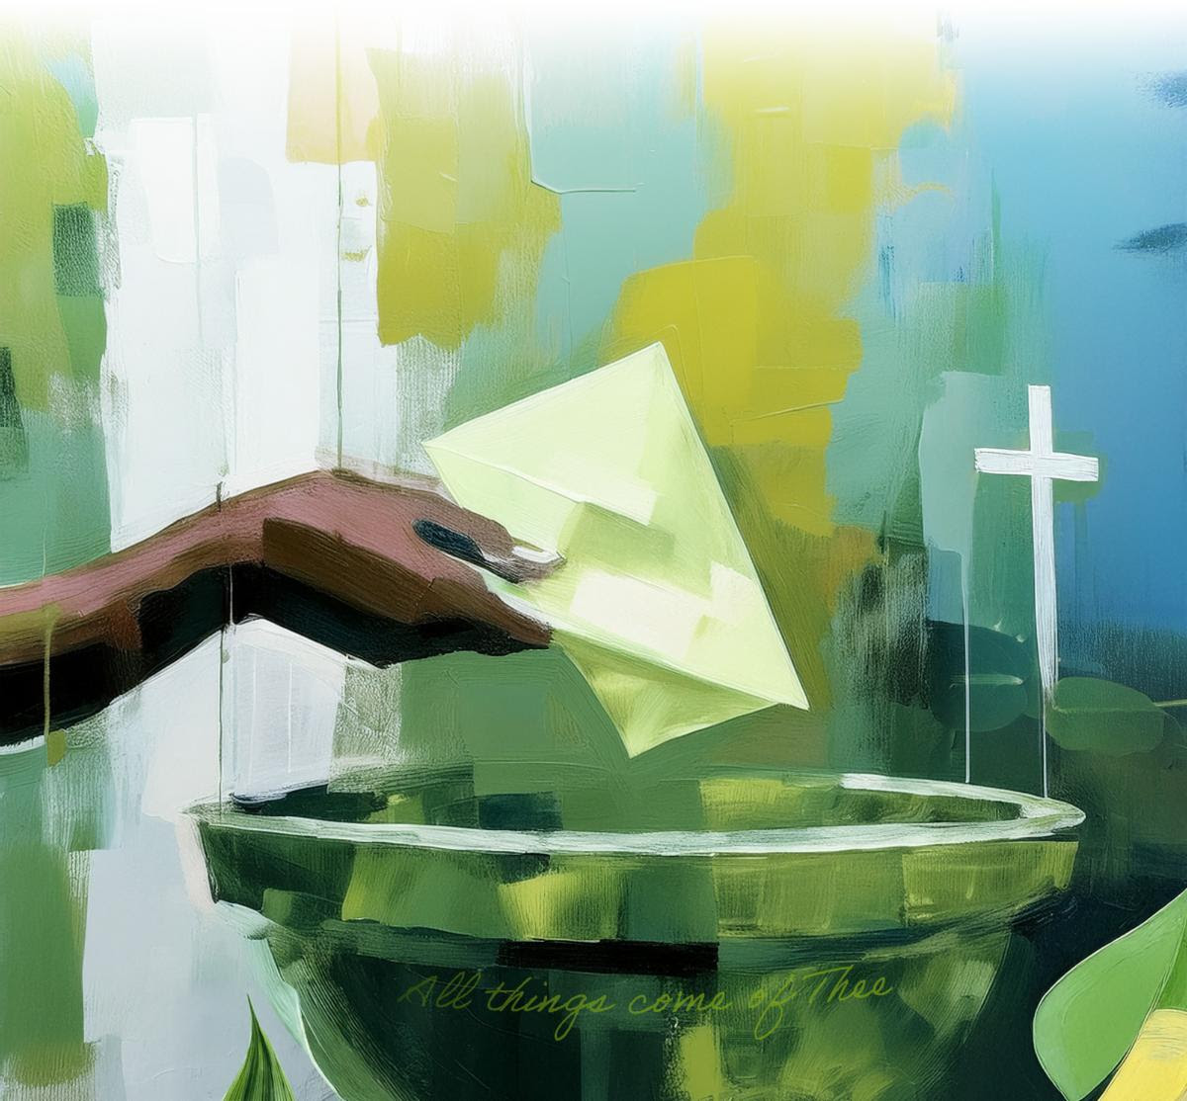
A Missional Budget

Slide 44
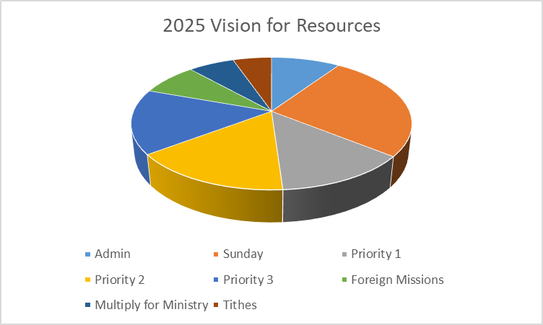
A Missional Budget

Slide 45
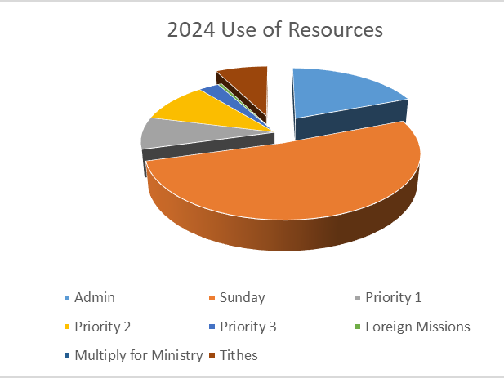
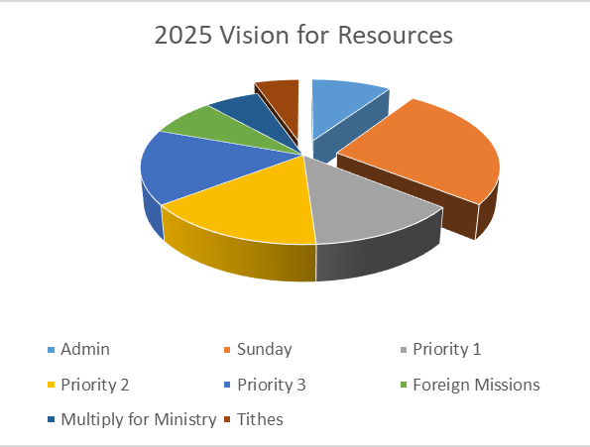
A Missional Budget

Slide 46
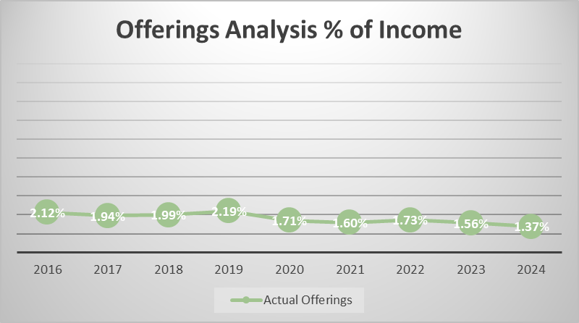
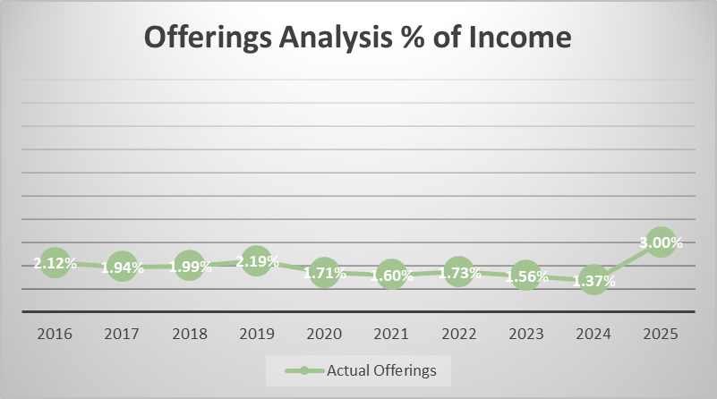
A Missional Budget

Slide 47
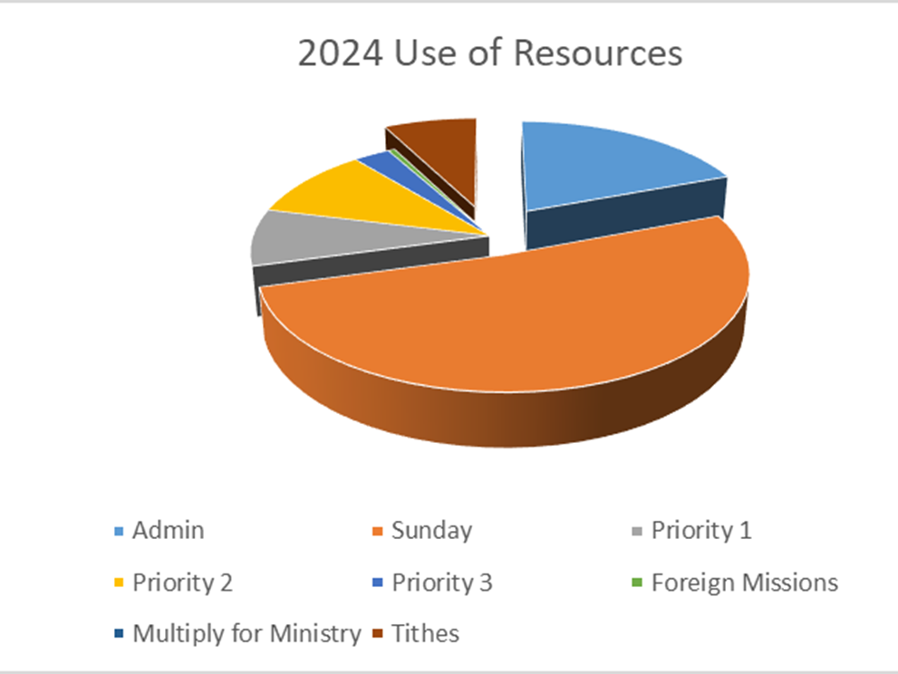
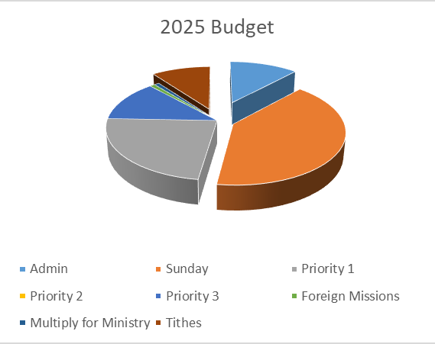
A Missional Budget

Slide 48
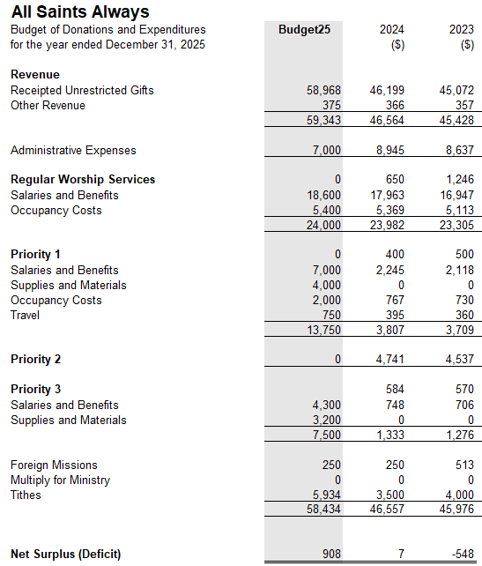
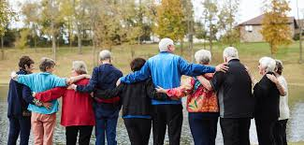
A Missional Budget

Slide 49
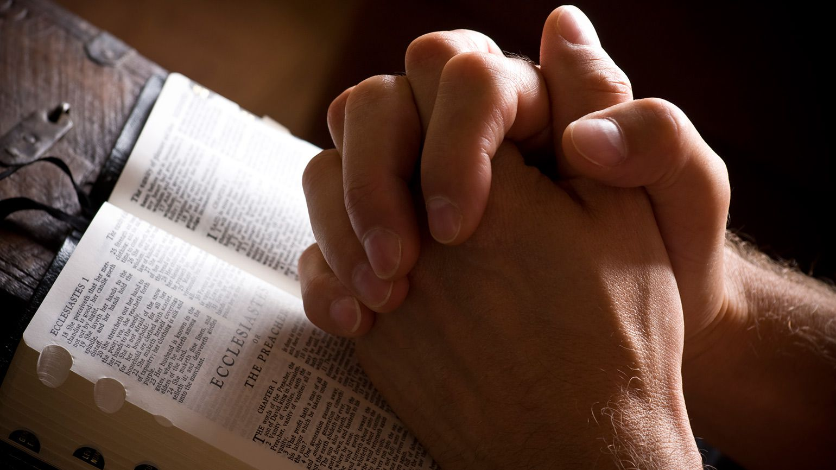
A Missional Budget

Slide 50
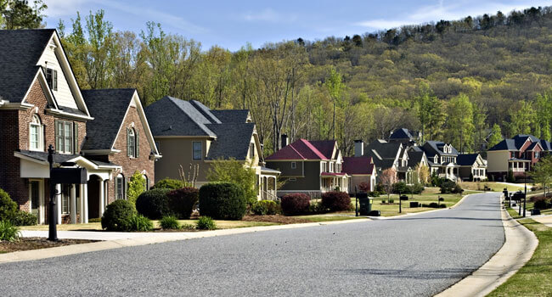
A Missional Budget

Slide 51
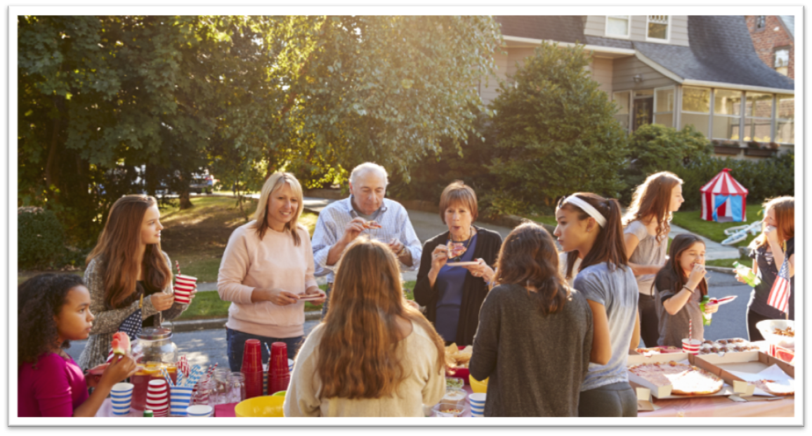
A Missional Budget

Slide 52
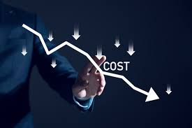
A Missional Budget

Slide 53

A Missional Budget

Slide 54


A Missional Budget

Slide 55
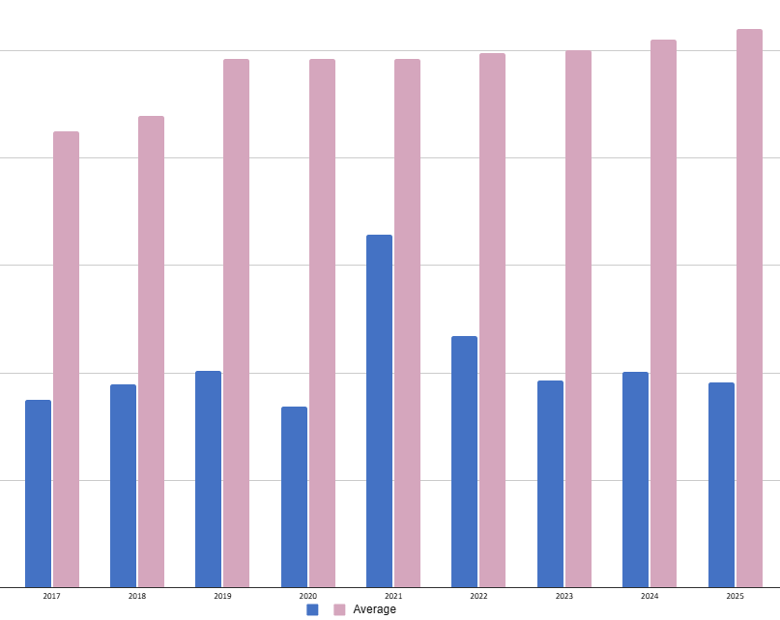

2025-2026 Budget Matthew 6:21
10% of Average Cdn. Income (2023)
Average Christian Donation

Slide 56
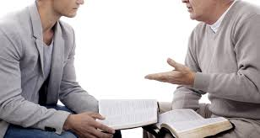
A Missional Budget

Slide 57

A Missional Budget

Slide 58
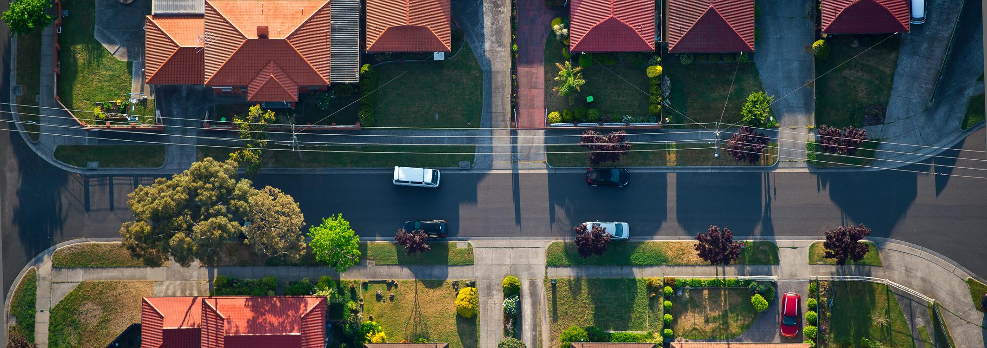
OUR Missional Budget

Slide 59

OUR Missional Budget

Slide 60

OUR Missional Budget

Slide 61

OUR Missional Budget

Slide 62

OUR Missional Budget

Slide 63
OUR Missional Budget
Almighty God our Savior, You desire that none should perish, and you have taught us through your Son that there is great joy in heaven over every sinner who repents:
Grant that our hearts may ache for a lost and broken world. May your Holy Spirit work through our words, deeds, and prayers, that the lost may be found and the dead made alive, and that all your redeemed may rejoice around your throne; through Jesus Christ our Lord. Amen.

